Slide 1
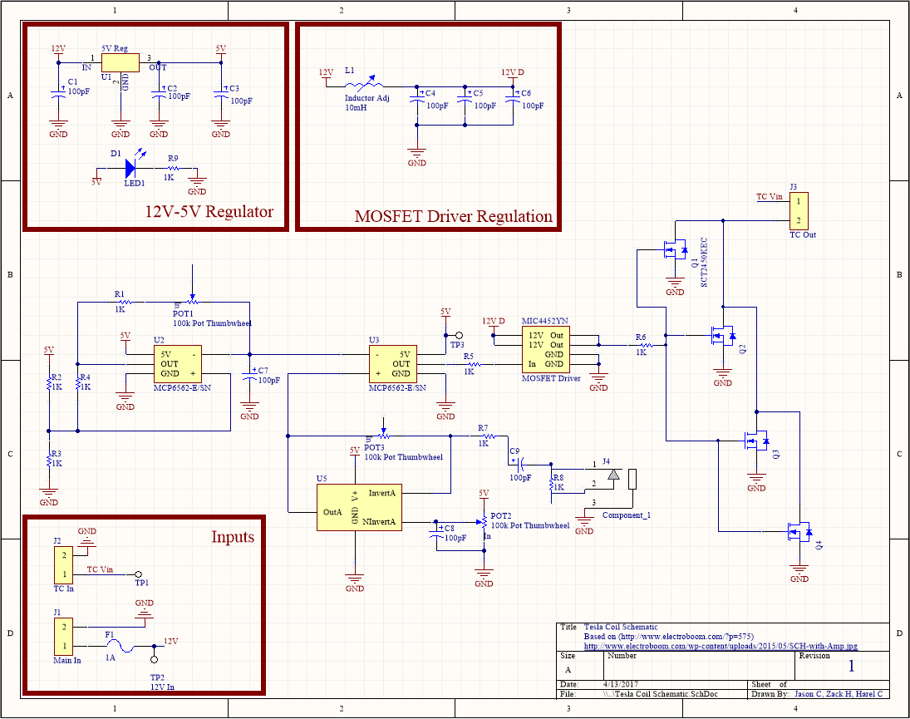
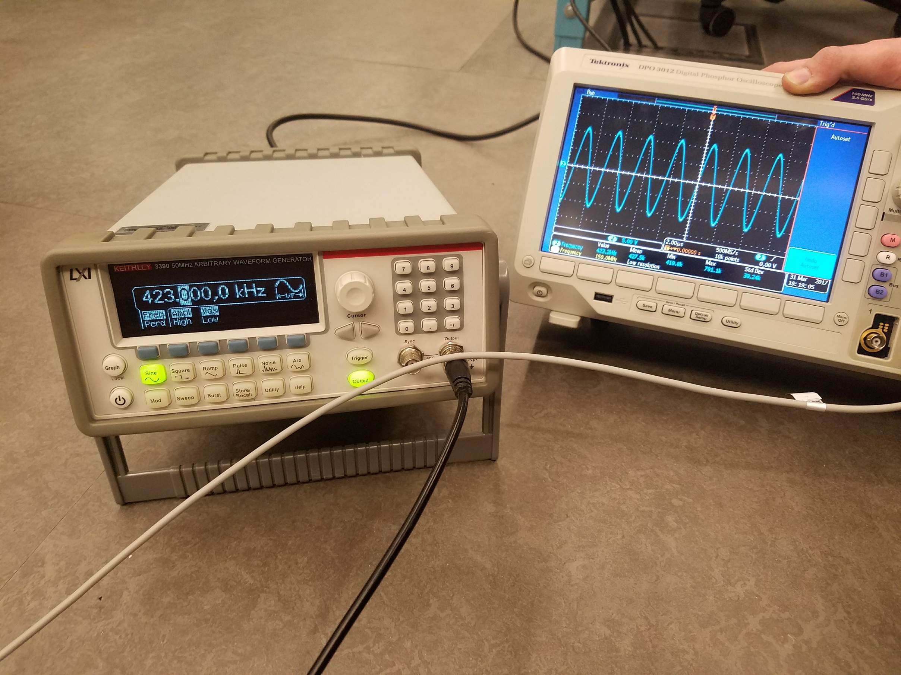
Department of Electrical and Computer Engineering
Freshman Research Initiative Symposium
April 24th, 2017
Jason Cheng, Zack Higgs, Harel Cohen
Observing Wireless Energy Transfer Using Tesla Coil Technology
Abstract
Methods
Conclusions
To research and learn about generating high voltage frequency and converting high frequency electromagnetic fields into useable energy. In doing this, we explore the field of wireless energy transfer, a well known idea recognized around the world, yet not fully explored. By exploring this, we hope to understand how to implement the technology into daily lives of people. With this research idea, we can create a new way to distribute energy to large areas, power electronics, charge batteries, and make this technology as commonplace as plugs and sockets are today.
To explore wireless energy transmission, a tunable Tesla Coil was designed and built. To accomplish the goals we had for tunable signals, we designed a Printed Circuit Board (PCB) that allows for 2 inputs of 12 volts and outputs 12 volts to run the Tesla Coil and a signal to control it.
Figure 1: Custom Schematic drawn for project
Results
Citation
S, Mehdi . "Music, Magic and Mayhem with Tesla Coil." ElectroBoom. May 26, 2015. Accessed April 09,
2017. http://www.electroboom.com/?p=575.
We would like to thank: The Electronics and Technology Group at Iowa State University and the Howard Hughes Medical Institute

